Slide 1











BWIA 121 - 55213790
INTEREST CALCULATOR
PRESENTATION
This presentation will provide instructions on the layout of the calculator as well as how to use it and how to access the website if further pictures/videos/instructions are needed to enhance your overall experience.
PRESENTED BY: DRYTTON BARNARD

Slide 2




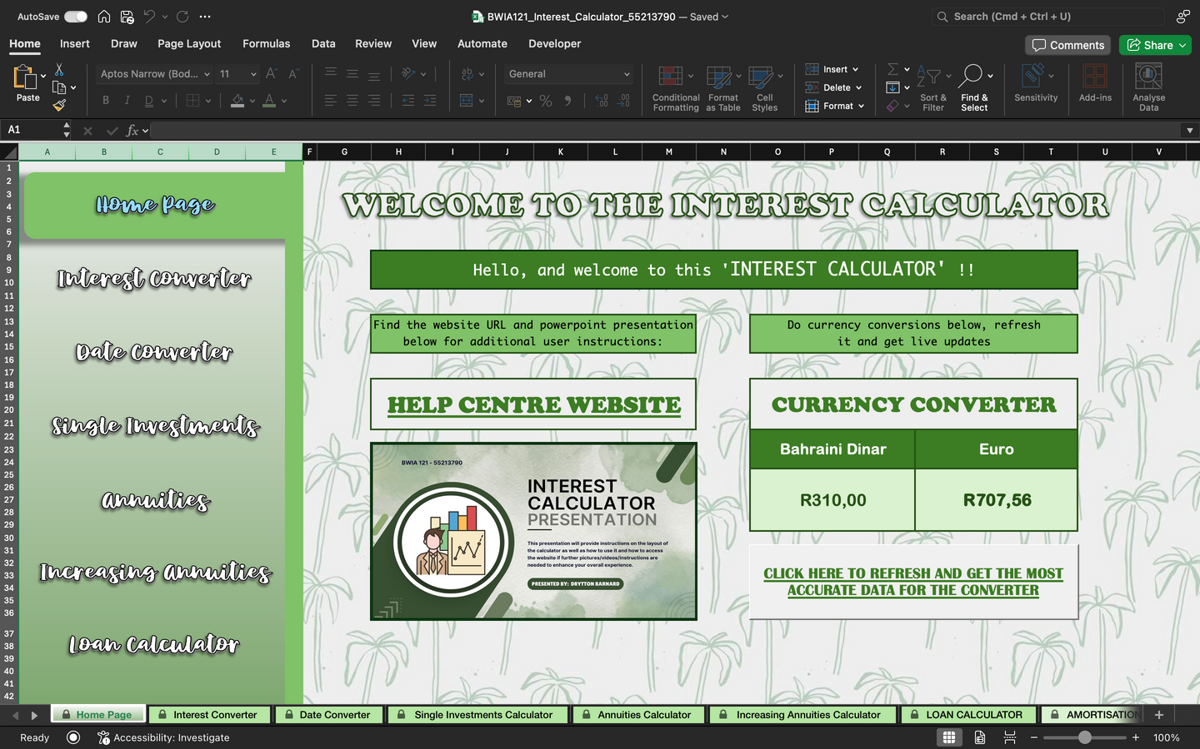
HOME PAGE
The home page is the welcome center of this Interest Calculator and it is also the place where a user will first interact with the navigation toggle located on the left side of the sheet.
On this home page there is a welcome message and a Currency Converter. The website and presentation can also be accessed here. On the toggle the user will find the following options to choose from to switch between the sheets in the workbook :
Home Page
Interest Converter
Date Converter
Single Investments
Annuities
Increasing Annuities
Loan Calculator

Slide 3

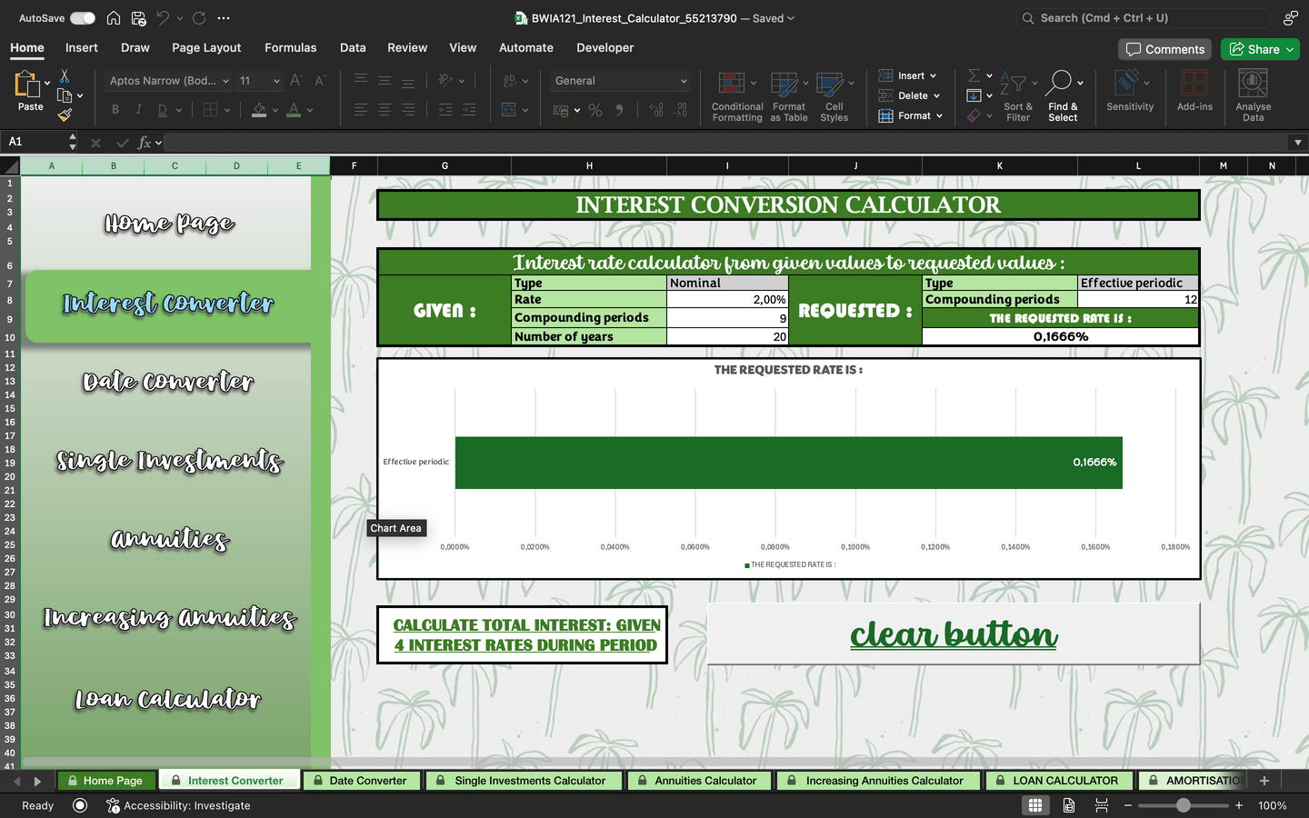
This is for conversions between any of the following interest rate types:
Simple interest rate
Nominal interest rate
Effective annual interest rate
Effective periodic interest rate
Force of interest
There is a graph to display the output value of the answer the calculator gave you. On this page the navigation toggle is still available for sheet navigation within the workbook.
There is also a visible “clear button” to reset all input values and allow for a complete new set op input values.
Also able to open Total Interest Sheet through the provided link.
Interest Converter

Slide 4

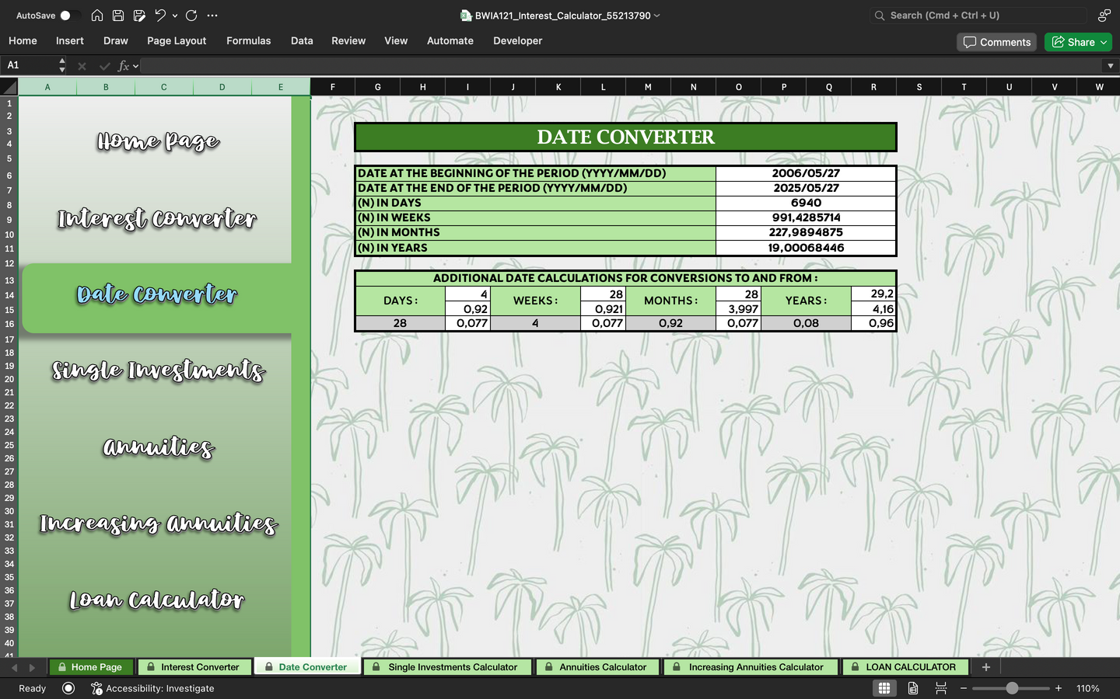
DATE CONVERTER
This is for any and all date conversions needed within the workbook.
Below the date converter there is an additional calculations part that allows you to convert between the following:
Days
Weeks
Months
Years
IMPORTANT NOTE: For proper use of these additional calculations make use of the comments added to guide you from what to what your converting.
The navigation toggle for sheet navigation within the workbook is also available here.

Slide 5

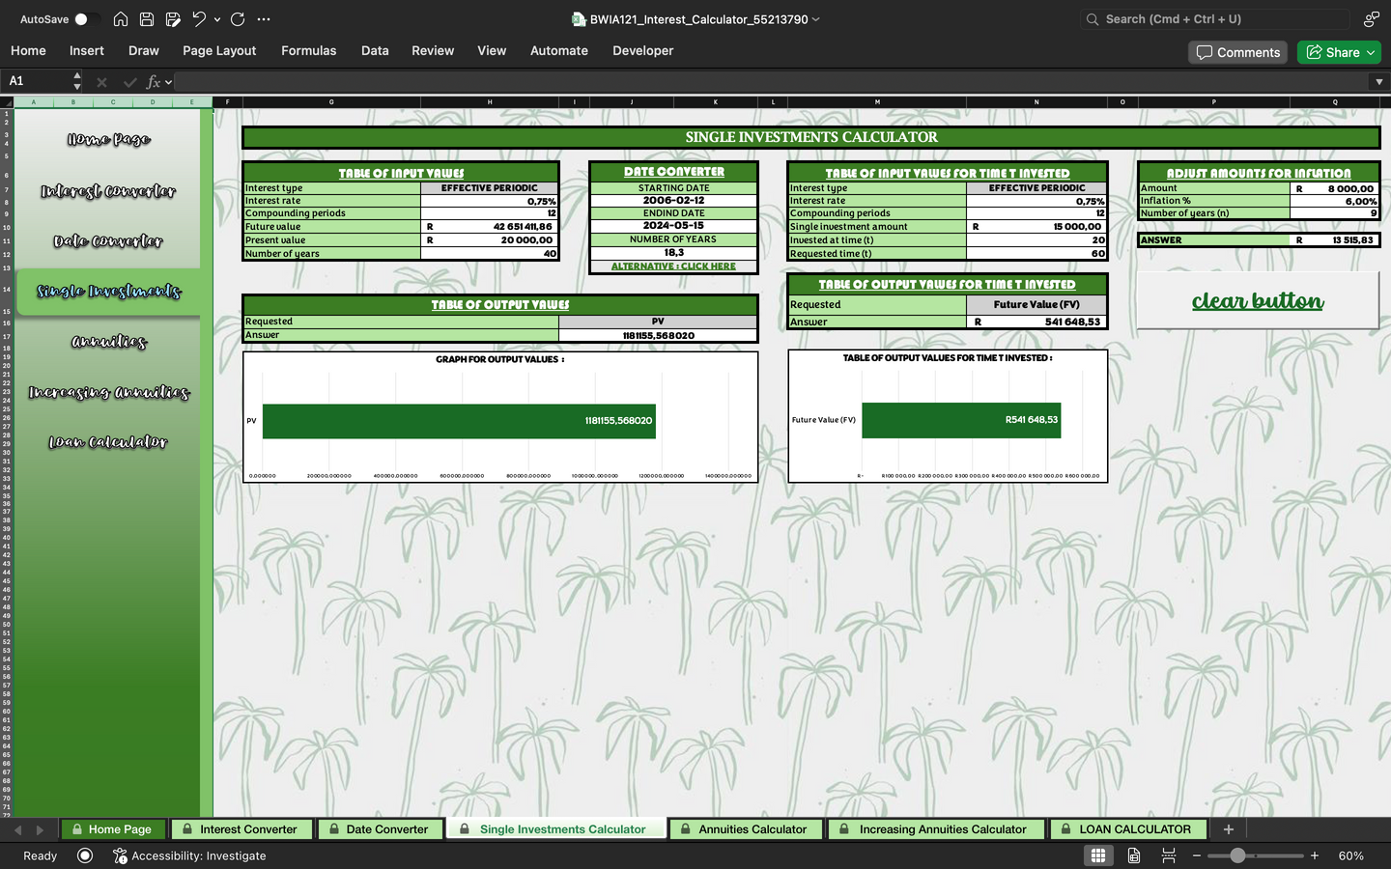
Single Investments Calculator that:
Uses different interest rates
Calculates future values
Calculates present values
Calculates interest rates required to achieve the future/present value given
Calculates the compounding period
Interest earned during the investment
Calculates the number of years of the investment
There is also an inflation adjustment calculator supplied in this sheet. And graphs are supplied. A small version of the date converter is supplied here. The navigation toggle for sheet navigation within the workbook is available for use. The “clear button” as previously mentioned is supplied for use. There will also be a link to the sheet name “Investment+Annuity”
Single Investments

Slide 6

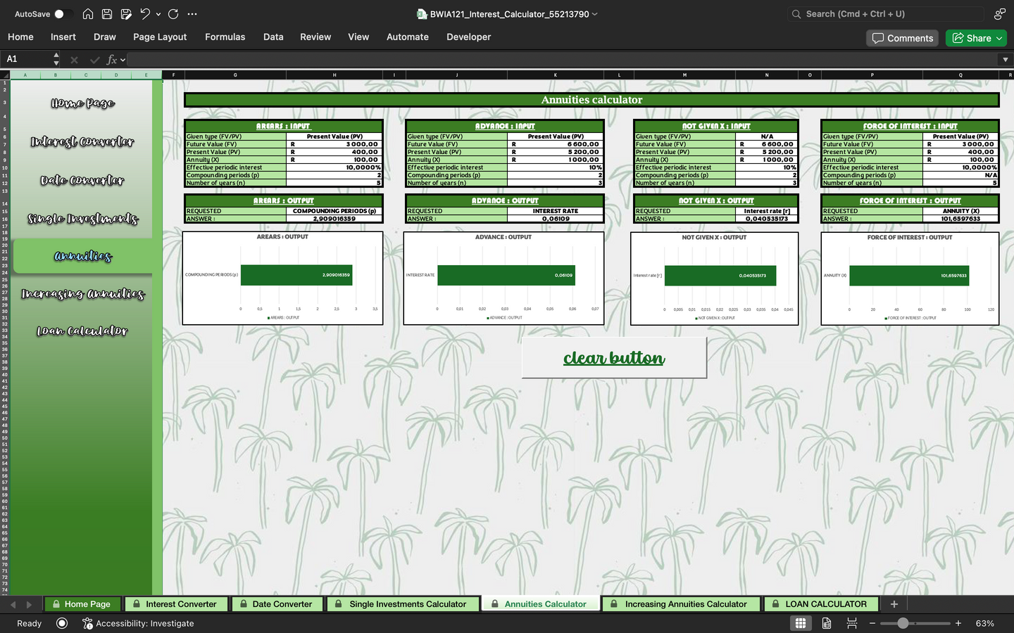
ANNUITIES
Annuities calculator that:
Calculates present/future values in advance, arrears, not given X and force of interest annuities.
Calculates years of accumulation in present and future value the 4 mentioned
Calculates interest rate required for future and present value for the 4 mentioned
Calculates payment amount required for future and present value for the 4 mentioned
Calculates the period for future and present value for the 4 mentioned
Graphs are supplied for convenience. The navigation toggle is available. The “clear button” is also supplied again. Also a link to “Investment+Annuity” sheet.

Slide 7
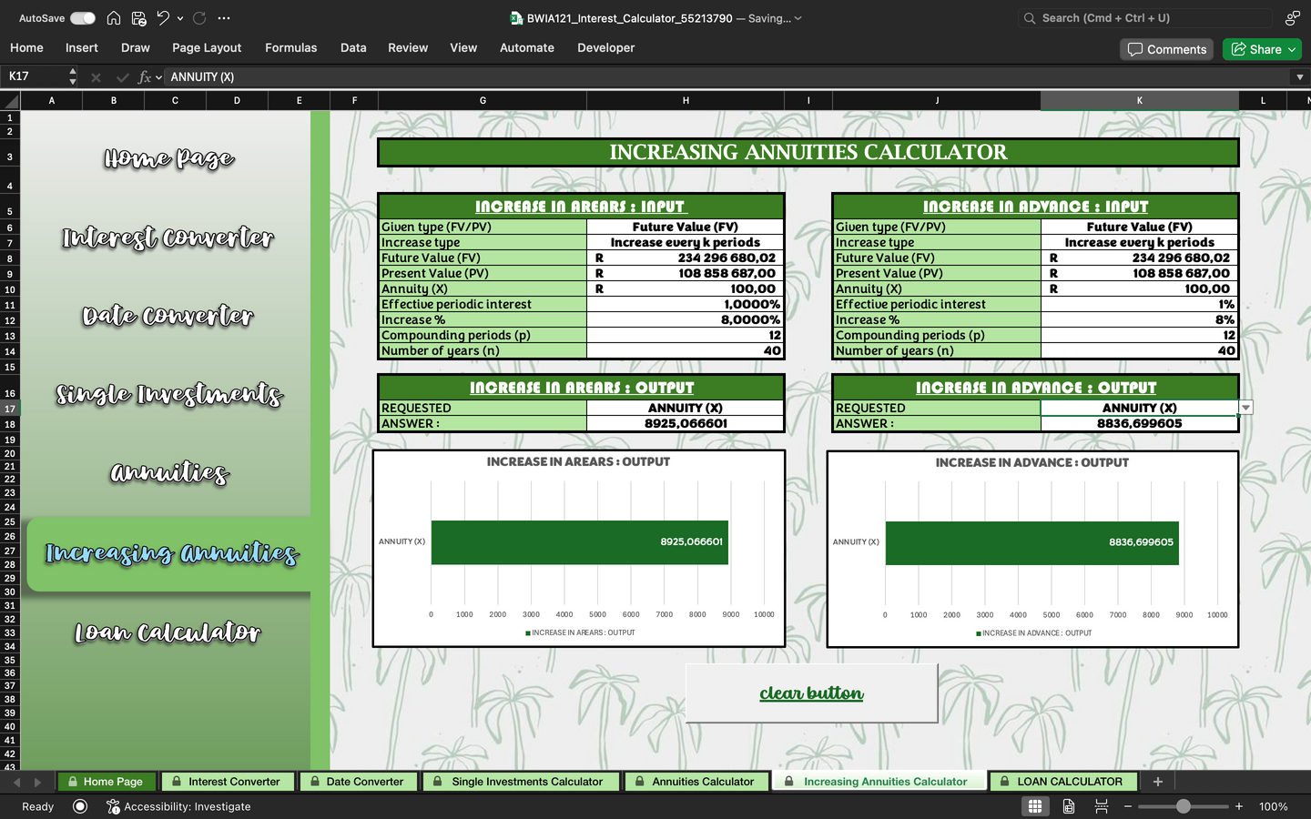

Increasing payment calculator that:
Calculates the present and future value for arrears and advance payments for both payments increasing every next period and payments increasing every k periods.
Calculate the payment amount in terms of the future and present value for arrears and advance payments for both payments increasing every next period and increasing every k periods
Graphs are supplied for convenience. The navigation toggle is available for sheet navigation within the workbook.
The “clear button” is also supplied again for use.
Increasing Annuities

Slide 8

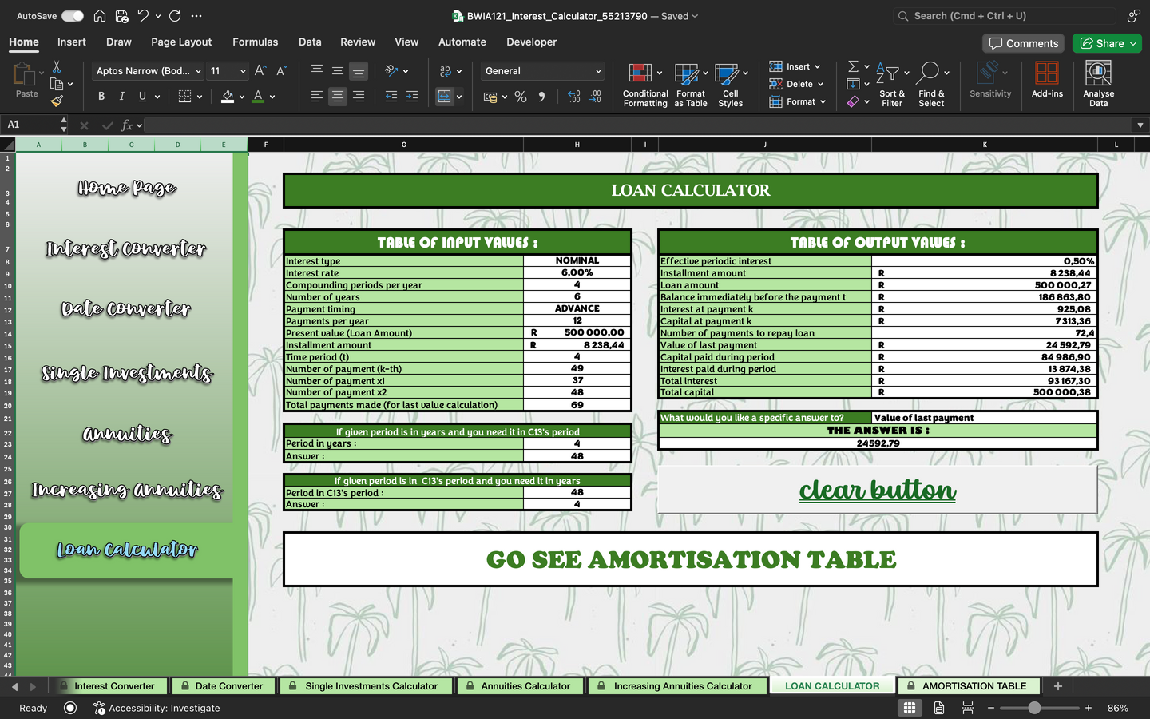
LOAN CALCULATOR
Loan Calculator that calculates:
Loan amount in advance and arrears.
Capital component of a specific payment.
Interest component of a specific payment.
The balance at a specific time (years).
Payment amount for advance and arrears.
The period to repay for advance and arrears.
The last payment amount.
Option to convert interest within the sheet. The navigation toggle is supplied again for sheet navigation.
The “clear button” is supplied again for user convenience. As well as a link to the Amortisation Table.

Slide 9





WEBSITE INSTRUCTIONS
Here you’ll find instructions of the purpose of the pages on the website and try and give you more clarity on how to navigate the site with ease.
HOME PAGE
PICTURES
VIDEOS
The home page of this site has full a search bar to ask questions that will also navigate you to the spesific thing/video/picture you are searching to find.
The is also an integrated AI assistant that will answer any questions are help with problems you are facing on the calculator.
Within the other pages, namely :
Interest Converter
Date Converter
Single Investment
Annuities
Increasing Annuity
Loan Calculator
will be where you can find related pictures that offer explanations through visual aids.
Within the other pages, namely :
Interest Converter
Date Converter
Single Investment
Annuities
Increasing Annuity
Loan Calculator
will be where you can find related videos that offer explanations through visual aids.

Slide 10

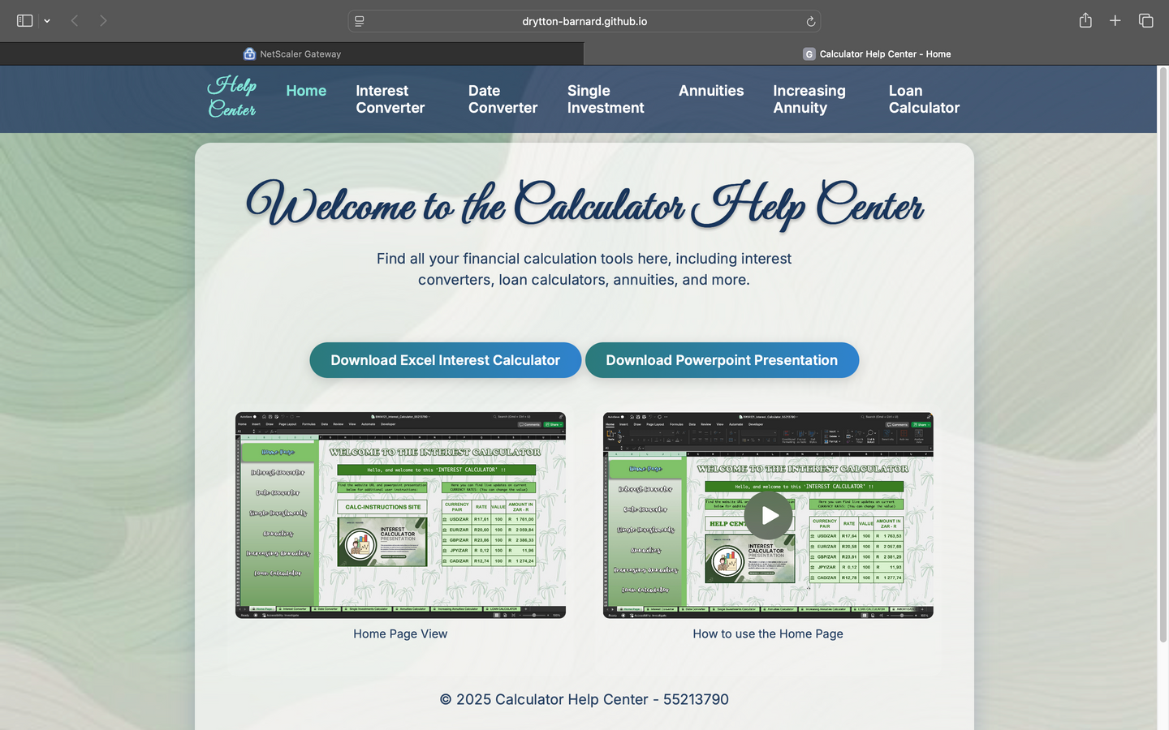
HELP CENTRE WEBSITE
As displayed in the picture, this website has the same toggle navigation sistem as the one found in the excel workbook.
This website contains additional sources such as videos and picture. This is also a user convenience feature to allow users to go on the website and access these “tutorials” with the aim to enhance their overall experience.
There are direct links on the website’s home page that allows users to download the Interest Calculator aswell as this presentation.

Slide 11


Thank you for using this Interest Calculator and it’s Information document!
DRYTTON BARNARD
55213790
55213790@mynwu.ac.za
BWIA 121

